Slide 1
HI

Slide 2
I AM CYRINE

Slide 3
MY TOPIC IS

Slide 4

PAGE TITLE
x

Slide 5
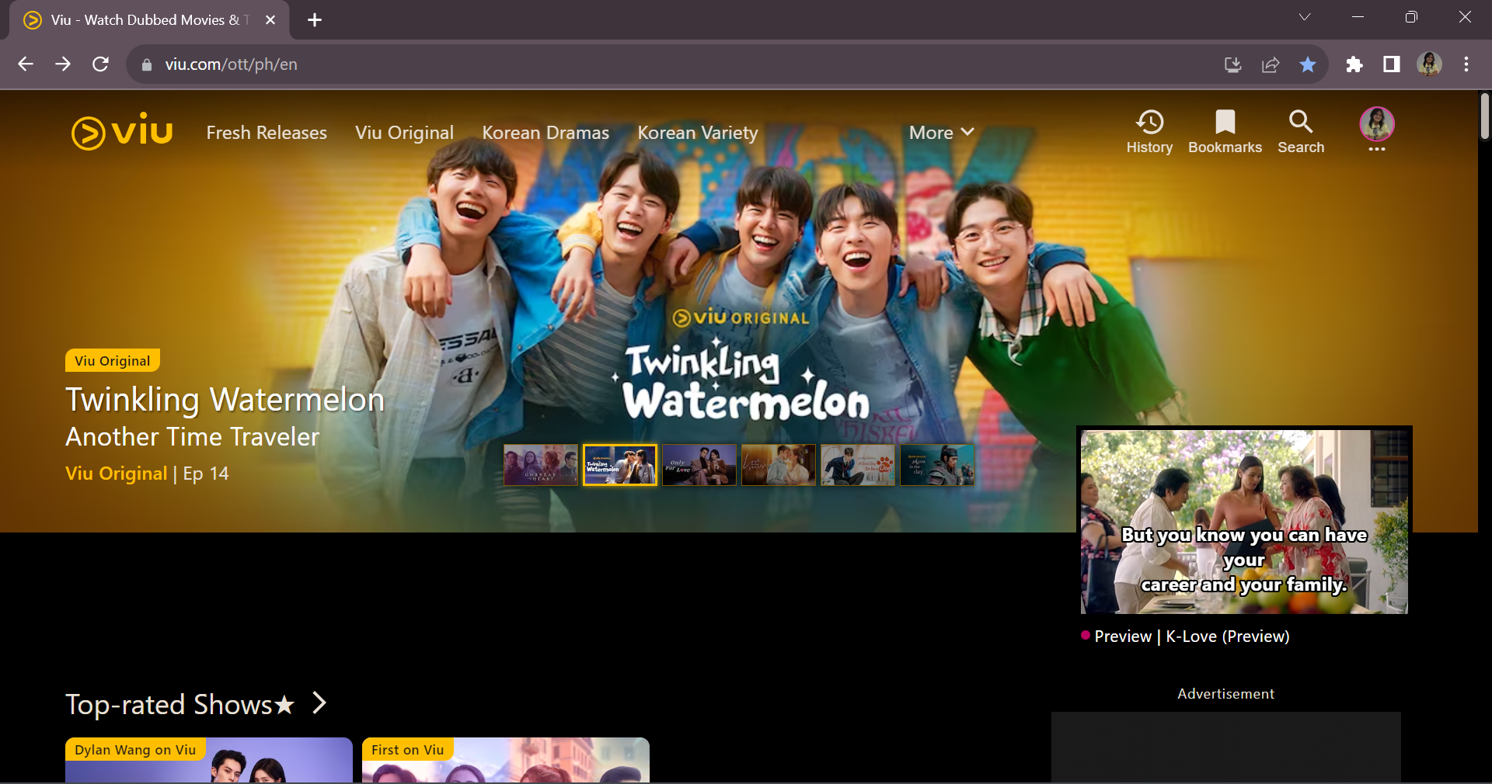

Slide 9
Every web page should have a page title to describe the meaning of the page.

Slide 10
LET’S CODE

